Slide 1
KAVERI 3.0 · DEPARTMENT OF STAMPS AND REGISTRATION, GOVERNMENT OF KARNATAKA
Business Requirements Document
User Management Module
Identity · Passwordless authentication · Sanctioned post occupancy · RBAC
Version 1 | 04 September 2026 Author: Nandha Kumar (Business Analyst)
Notes:
Walkthrough of the User Management BRD v4.18 for the KAVERI 3.0 platform. All diagrams in this deck are the approved figures embedded in the BRD itself.

Slide 2
CONTENTS
Agenda
— 1. Introduction, scope and business objectives
— 2. Identity and passwordless authentication — Citizens, DSR Officers, Other Department users
— 3. Posts, roles and role-based access control
— 4. DSR Officer lifecycle — creation, transfer, occupancy and temporary absence
— 5. Non-functional requirements
KAVERI 3.0 · User Management BRD v4.18 · Department of Stamps and Registration, Government of Karnataka
2

Slide 3
Three user categories, one User Master
User category | Username | Authentication | Lost-mobile reset
Public (Citizen) | Preferred Username entered by the user at registration | Username + Captcha + OTP to mobile | Self-service: 3 of 5 security questions + PIN to registered email + OTP to new mobile
DSR Officer | KGID | Username (KGID) + Captcha + OTP to mobile + Biometrics | Not available — administrator changes the mobile with reason and audit
Other Department | KGID | Username (KGID) + Captcha + OTP to mobile + Biometrics | Not available — administrator changes the mobile with reason and audit
KAVERI 3.0 · User Management BRD v4.18 · Department of Stamps and Registration, Government of Karnataka
11

Slide 4
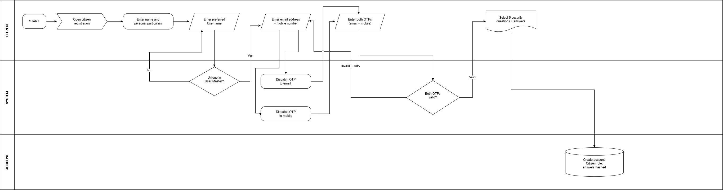
Citizen self-registration
KAVERI 3.0 · User Management BRD v4.18 · Department of Stamps and Registration, Government of Karnataka
13

Slide 5
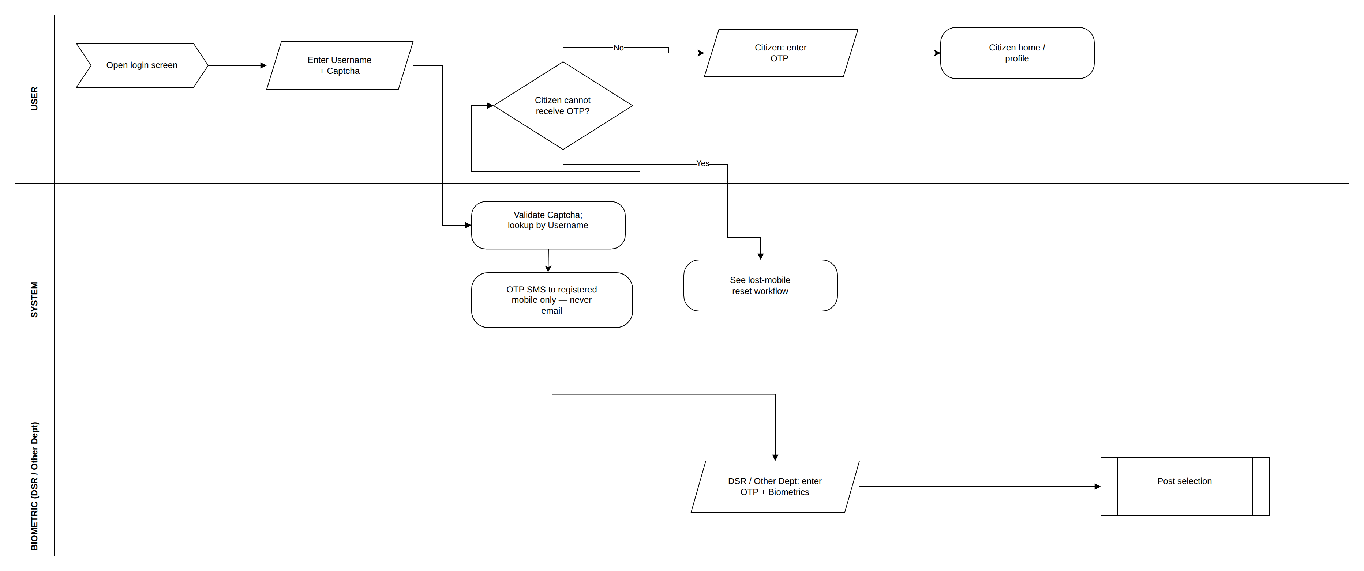
Login across all categories
KAVERI 3.0 · User Management BRD v4.18 · Department of Stamps and Registration, Government of Karnataka
14

Slide 6
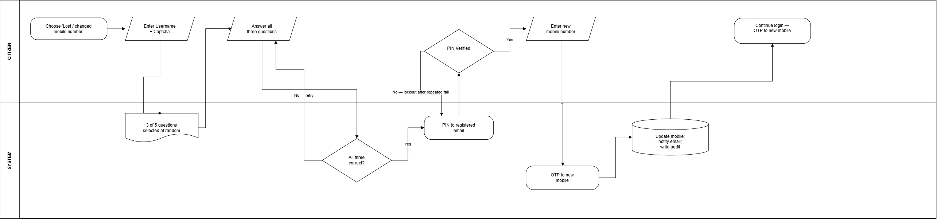
Citizen lost-mobile reset
KAVERI 3.0 · User Management BRD v4.18 · Department of Stamps and Registration, Government of Karnataka
15

Slide 7
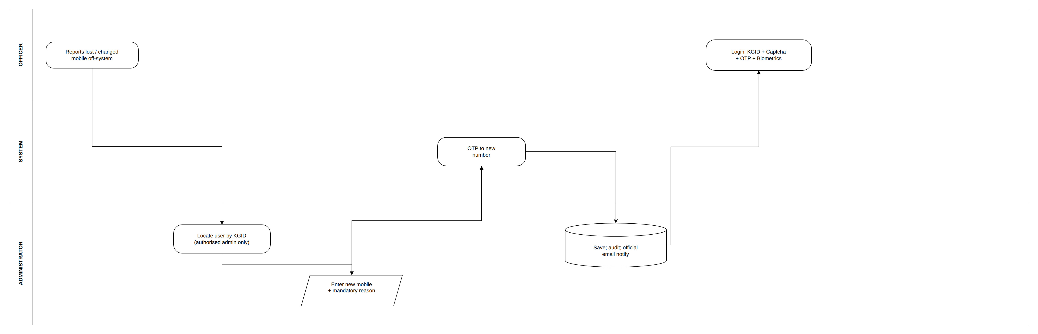
Departmental mobile change — administrator only
KAVERI 3.0 · User Management BRD v4.18 · Department of Stamps and Registration, Government of Karnataka
16

Slide 8
OTP and session policy
Applies to every user category. The 15-minute idle timeout matters most on shared SRO counter machines, where the session post is fixed for the whole session.
Control | Rule
Login OTP validity | 5 minutes from dispatch (IST)
OTP length | 6 numeric digits
Incorrect entries per OTP | Maximum 3, then the OTP is invalidated
OTP Resend cooldown | 30 seconds; maximum 3 resends per channel per 15 minutes
Failed-login lockout | 3 failures lock the Username for 15 minutes
Idle timeout | 15 minutes of inactivity ends the session
Absolute session limit | 8 hours from login, even if the user is active
Concurrent sessions | One per Username — last login wins
KAVERI 3.0 · User Management BRD v4.18 · Department of Stamps and Registration, Government of Karnataka
17

Slide 9
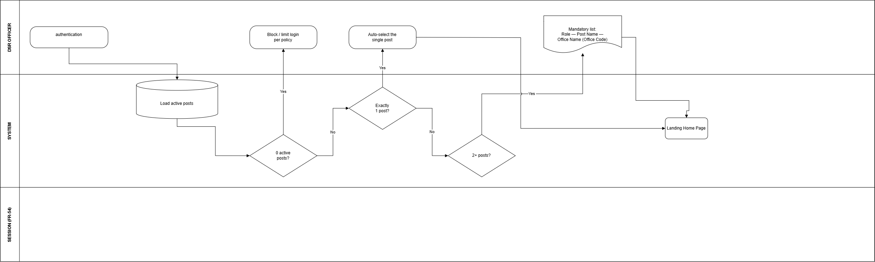
DSR Officer post selection at login
KAVERI 3.0 · User Management BRD v4.18 · Department of Stamps and Registration, Government of Karnataka
19

Slide 10
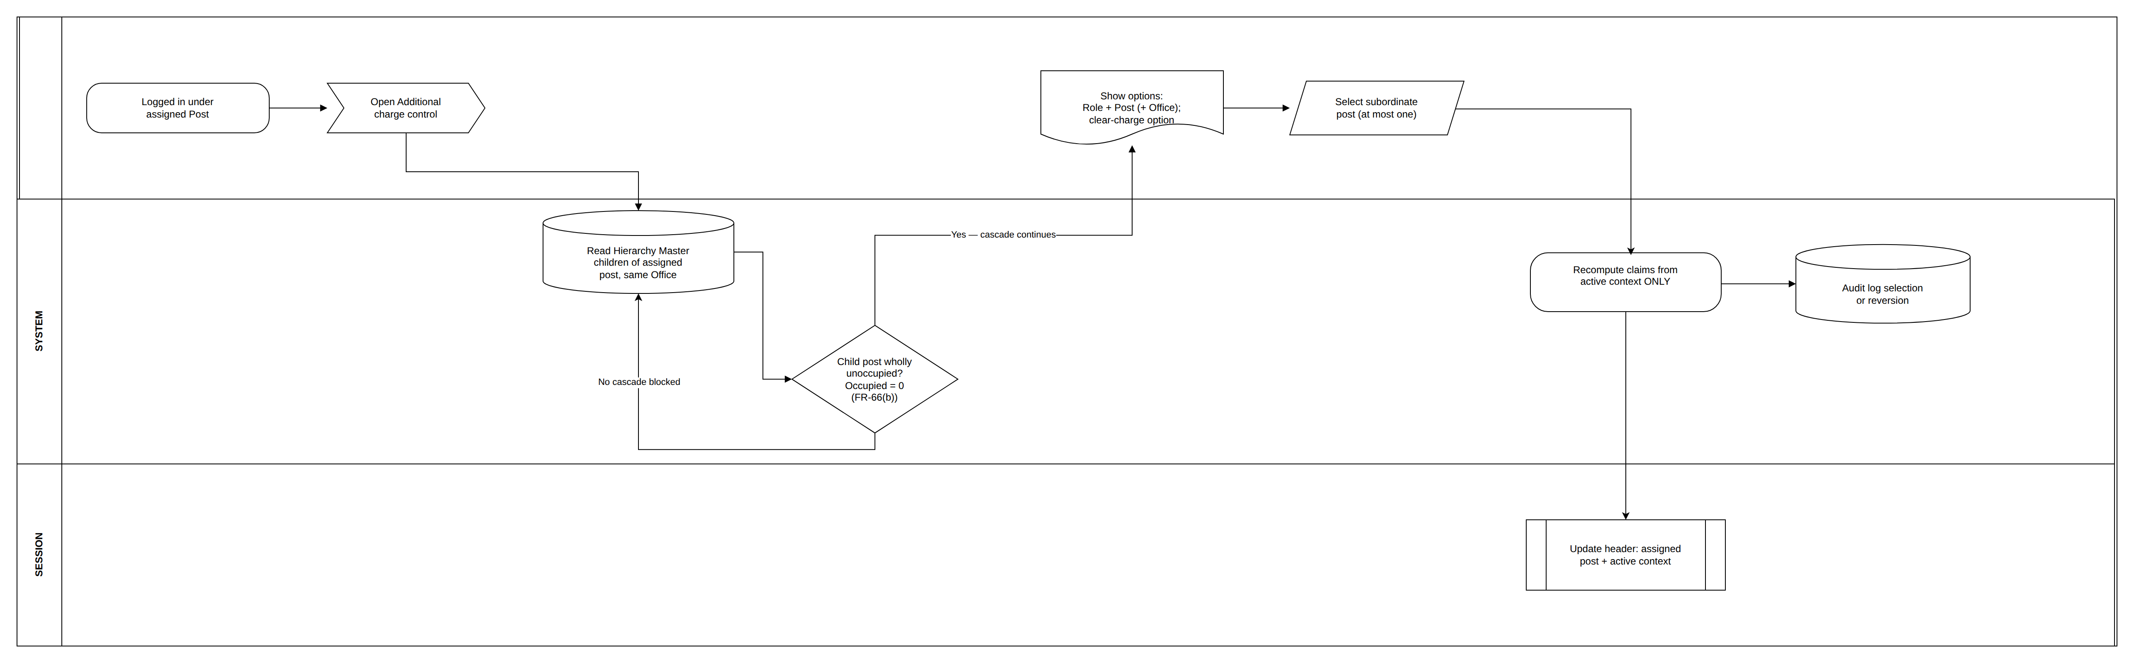
Additional charge of an unoccupied subordinate post
KAVERI 3.0 · User Management BRD v4.18 · Department of Stamps and Registration, Government of Karnataka
20

Slide 11
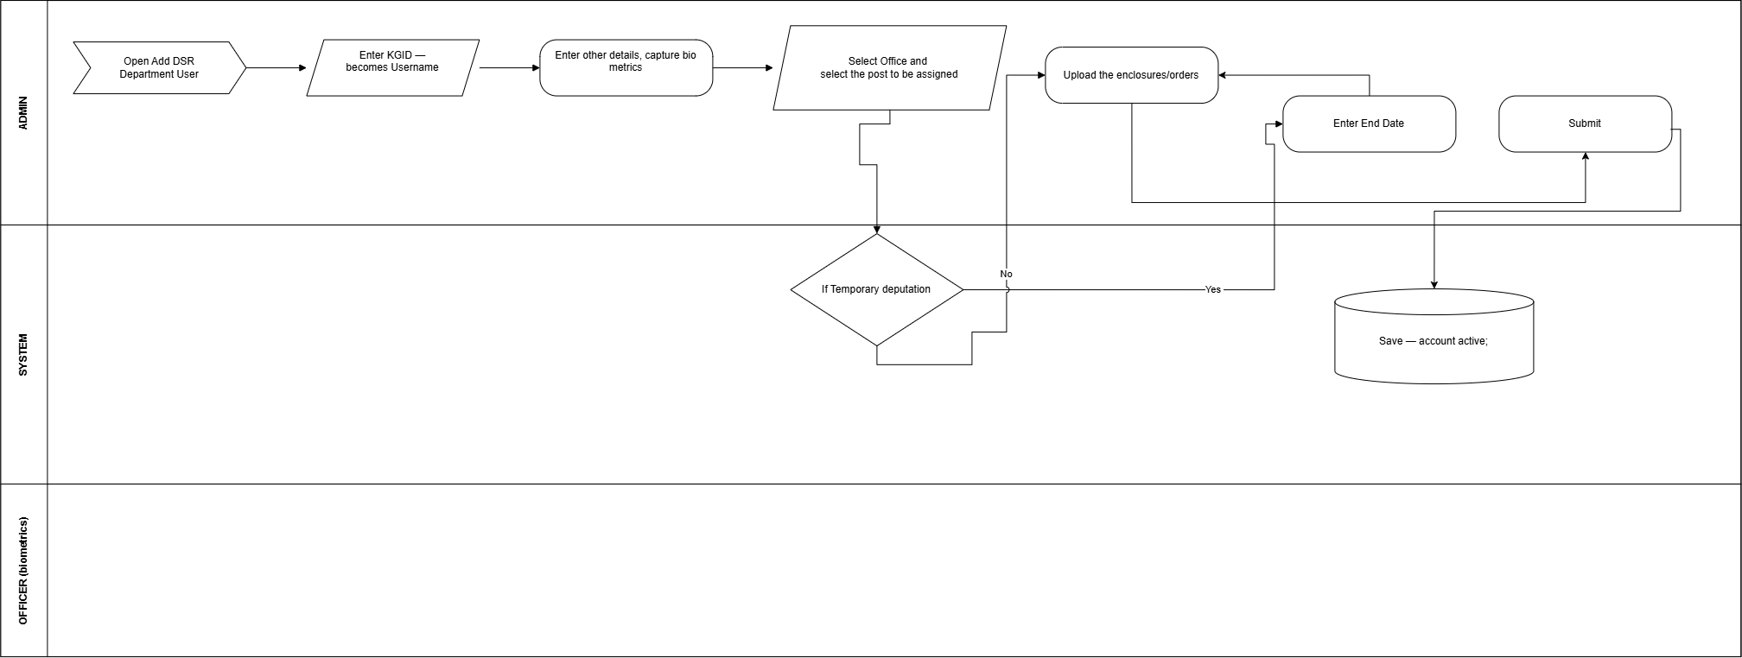
DSR Officer creation with post assignment
KAVERI 3.0 · User Management BRD v4.18 · Department of Stamps and Registration, Government of Karnataka
29

Slide 12
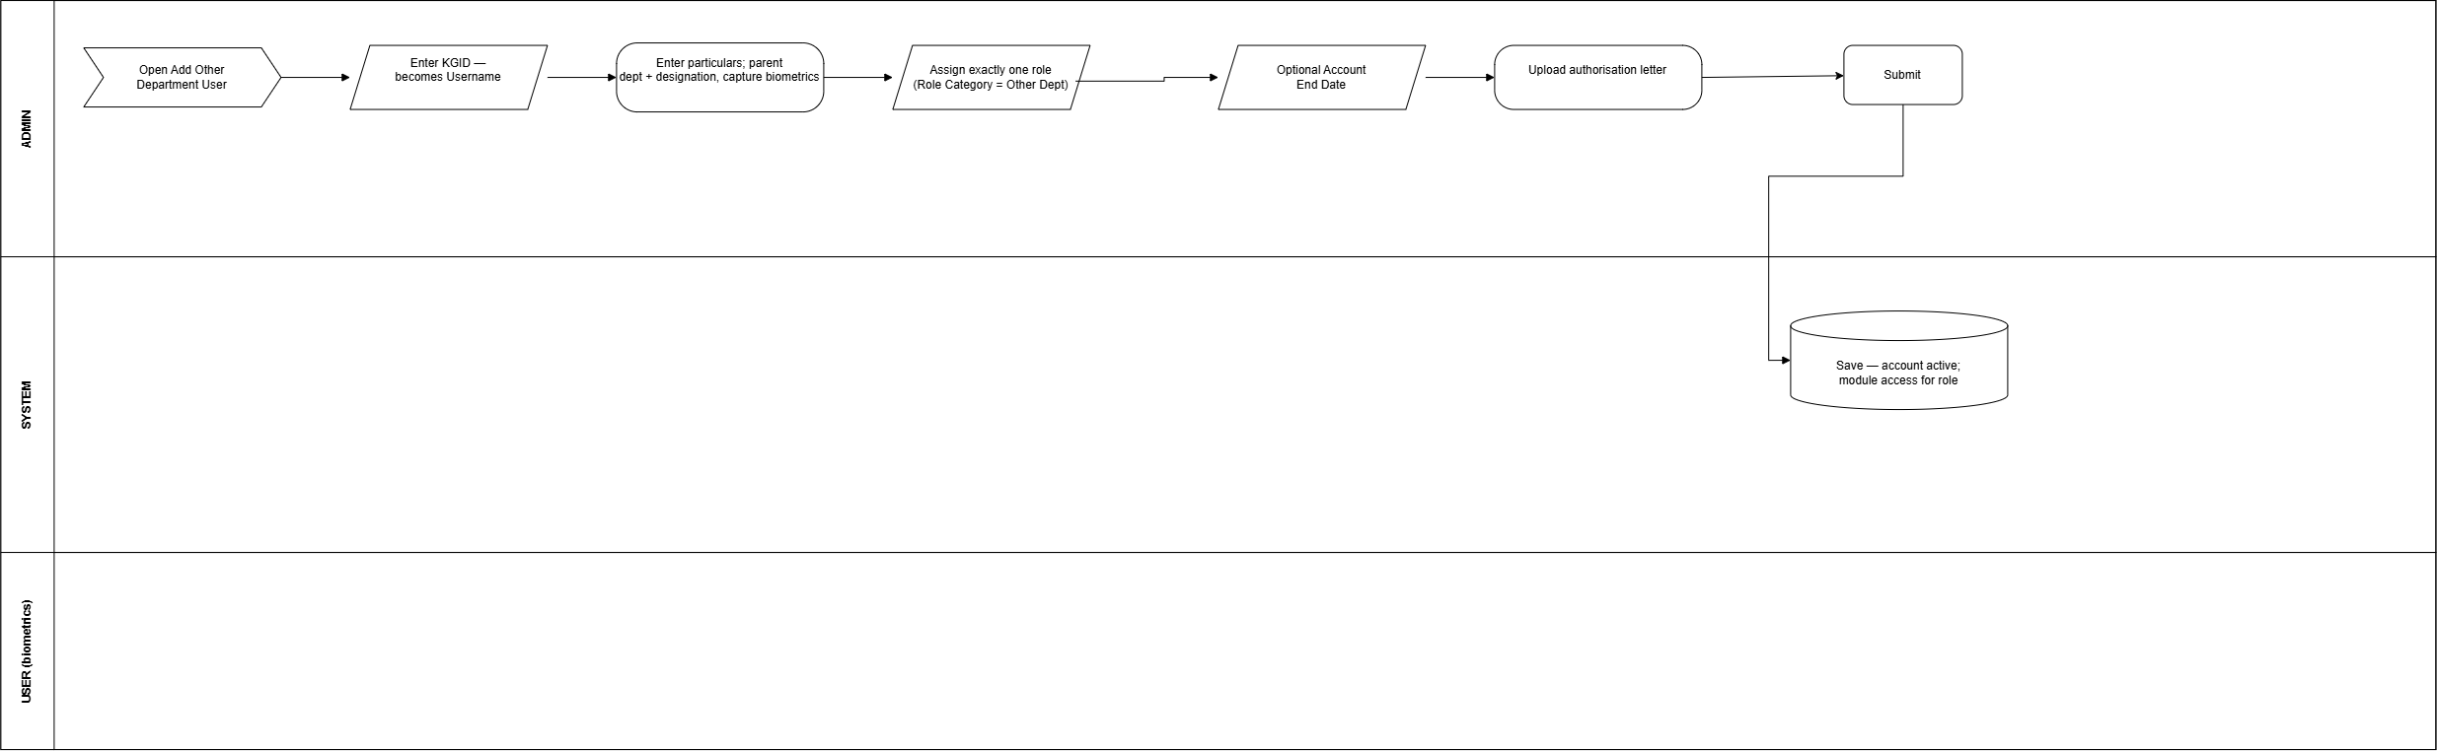
Other Department user creation
KAVERI 3.0 · User Management BRD v4.18 · Department of Stamps and Registration, Government of Karnataka
30

Slide 13
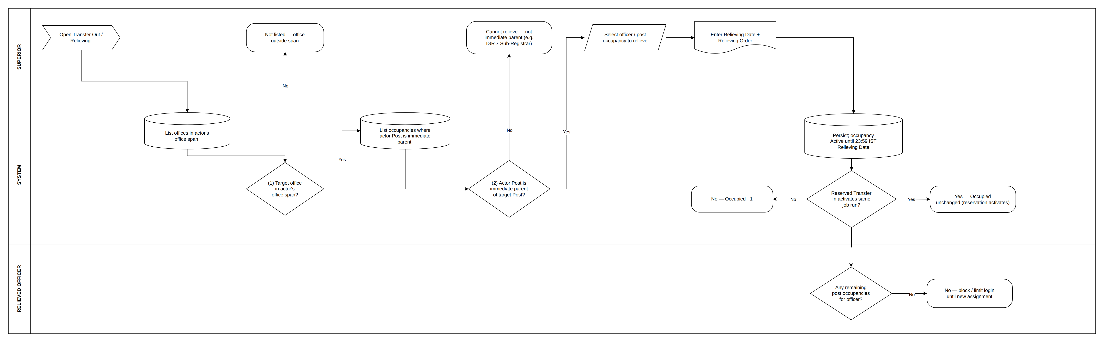
Transfer Out and relieving
KAVERI 3.0 · User Management BRD v4.18 · Department of Stamps and Registration, Government of Karnataka
31

Slide 14
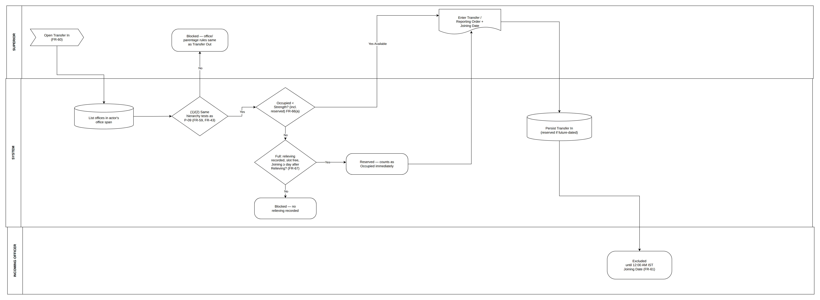
Transfer In
KAVERI 3.0 · User Management BRD v4.18 · Department of Stamps and Registration, Government of Karnataka
32

Slide 15
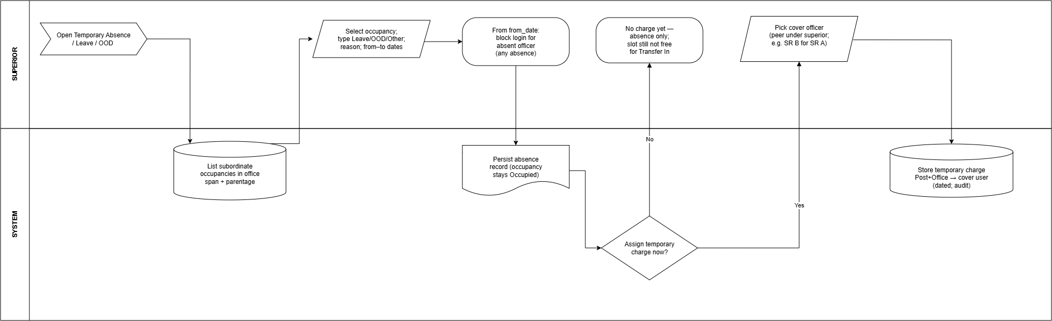
Temporary absence — Leave, OOD and in-charge
KAVERI 3.0 · User Management BRD v4.18 · Department of Stamps and Registration, Government of Karnataka
35

Slide 16
Non-functional requirements
SECURITY AND PERFORMANCE
— No password storage anywhere; the login OTP goes only to the registered mobile.
— TLS 1.2 or higher for all data in transit;
— Security-question answers stored hashed, never displayed, never entered by an administrator.
— OTP dispatch within 5 seconds; authentication completes within 2 seconds after verification.
— Minimum 10000 concurrent authenticated sessions at launch, validated in performance testing.
KAVERI 3.0 · User Management BRD v4.18 · Department of Stamps and Registration, Government of Karnataka
37

Slide 17
Reporting requirements
— Active, inactive and suspended users; role and permission assignments across all users.
— Audit log of login attempts, successful and failed, over a selected date range.
— Sanctioned post occupancy — sanctioned strength, occupied count, remaining capacity and wholly-unoccupied flag per office
— Additional charge report and Temporary Absence / Temporary Charge report
— Transfer Out / Transfer In history and officer posting / service history.
KAVERI 3.0 · User Management BRD v4.18 · Department of Stamps and Registration, Government of Karnataka
38

